Slide 1
Epidemic thunderstorm asthma campaign
MULTICULTURAL RESOURCE PACK
KEY MESSAGES AND CAMPAIGN ASSETS November 2020

Slide 2
INTRODUCTION
Grass pollen season runs from October to the end of December, bringing an increase in asthma and hay fever and the chance of epidemic thunderstorm asthma (ETSA).
When this event occurred in Victoria in November 2016, thousands of people developed breathing difficulties. For many of those affected, it was their first asthma attack. They were unaware of the risk to their health and of the steps to take to protect themselves or those in their care.
An ETSA event is thought to be triggered by an uncommon combination of high grass pollen levels and a certain type of thunderstorm.
Individual management of asthma and hay fever and preparedness is therefore the focus of the ETSA public awareness campaign.

Slide 3
INTRODUCTION
A range of translated resources are available to provide people from a wide range of CALD backgrounds with information in their own language.
As community leaders, you can help keep your community safe by sharing this information and raising awareness about the dangers of thunderstorm asthma.
Your assistance in sharing the information in this pack is greatly appreciated.
Further information is available at:
https://www.betterhealth.vic.gov.au/thunderstormasthma
Translated resources are available at: https://www2.health.vic.gov.au/public-health/environmental-health/climate-weather-and-public-health/thunderstorm-asthma/toolkit

Slide 4
WHAT YOU CAN DO TO HELP
You can help protect your community by encouraging them to understand epidemic thunderstorm asthma and to learn asthma first aid.
Share the materials and messages in this kit with your community by email, social media or messaging apps.
Promote the posters – they can be printed and displayed at community venues.
Share the videos and other information on the Epidemic Thunderstorm Asthma campaign pages on the Better Health Channel: https://www.betterhealth.vic.gov.au/health/conditionsandtreatments/ thunderstorm-asthma
Advise anyone concerned about their health to see their doctor. In an emergency call 000.

Slide 5
MESSAGING
The 2020 grass pollen season goes from October to the end of December, bringing an increase in asthma and hay fever and the chance of epidemic thunderstorm asthma.
Those considered at risk of thunderstorm asthma include people with asthma or hay fever, including those with undiagnosed asthma. Where possible, people with asthma and hay fever should also avoid exposure to springtime thunderstorms, especially the wind gusts that precede them.
All those with asthma, and particularly those with mild asthma, should see their GP now to develop or review their asthma action plan and make sure any associated hay fever is well managed.
They should always follow their asthma action plan or hay fever treatment plan and know asthma first aid.

Slide 6
MESSAGING
Hay fever or asthma can produce symptoms that are similar to coronavirus (COVID-19) such as a runny nose, cough or shortness of breath, and while good management can help prevent these, it is critical to still get tested for coronavirus once they occur and stay home while awaiting results.
Check the risk forecast daily, download the VicEmergency app on your mobile phone and set up a ‘watch zone’ to receive thunderstorm asthma warnings.
For more information about epidemic thunderstorm asthma: https://www.betterhealth.vic.gov.au/thunderstormasthma
For information about coronavirus (COVID-19) including advice on any current restrictions: https://www.dhhs.vic.gov.au/coronavirus

Slide 7
The ETSA forecasting system
The thunderstorm asthma forecast system spans three days (today, tomorrow and the day after) and uses a color-coded scale from low risk to high risk: green (low risk), orange (moderate risk) and red (high risk).
The forecast only indicates whether the chance of an epidemic thunderstorm asthma event occurring is increased – a higher forecast does not mean that an event is going to happen, and a lower forecast doesn’t mean that an event will not happen.
It is also important to note that the forecasting system has been designed to forecast the risk of epidemic thunderstorm asthma events, where a large number of people develop asthma symptoms over a short period of time.
It is not designed to forecast the risk of individual’s developing asthma and hay fever symptoms, which occur every year during the grass pollen season.

Slide 8
WHAT TO DO ON A HIGH-RISK DAY
Avoid being outside during thunderstorms - especially in the wind gusts that come before the storm and particularly on high risk days. Go inside and close your doors and windows, and if you have your air conditioner on, turn it to recirculate.
If you have asthma and hay fever, have your reliever medication readily available.
Follow your management plan and be alert to and act on the development of asthma symptoms.
Check the VicEmergency website or app for warnings in your area.

Slide 9
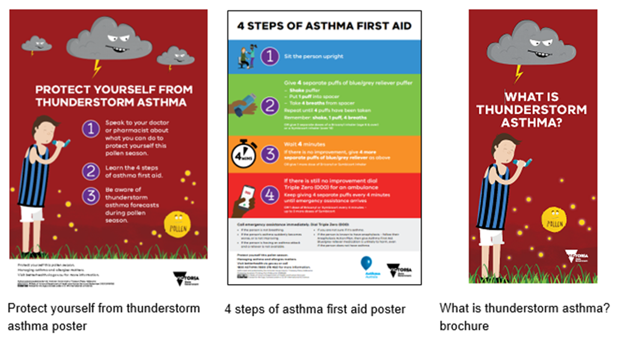
TRANSLATED RESOURCES
Translated resources (printed)
Printed resources in community languages can be ordered via the online order form link at: https://www2.health.vic.gov.au/public-health/environmental-health/climate-weather-and-public-health/thunderstorm-asthma/toolkit

Slide 10
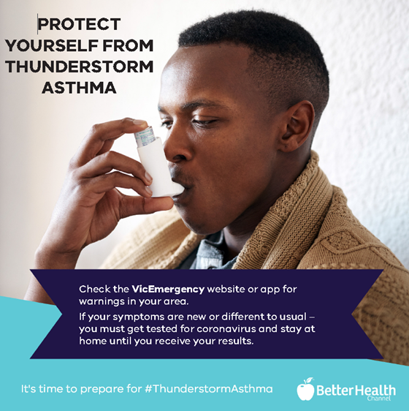
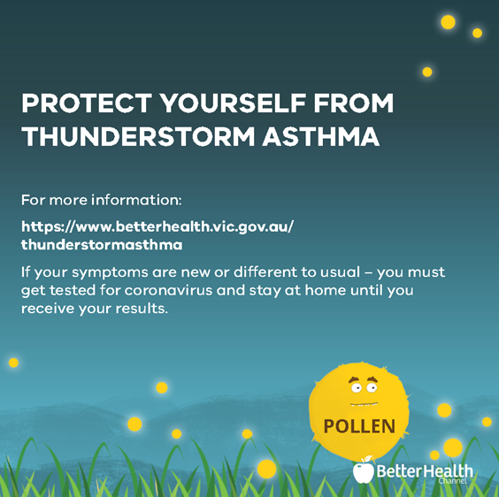
TRANSLATED RESOURCES
These posts are available in English and community languages at:
https://www2.health.vic.gov.au/public-health/environmental-health/climate-weather-and-public-health/thunderstorm-asthma/thunderstorm-asthma-multicultural-resources

Slide 11
FOR MORE INFORMATION
Contact the Department of Health and Human Services
by phone on 1300 761 874
or email: environmental.healthunit@dhhs.vic.gov.au

