Slide 1
Department of Health
Performance Support Program – Class B Cemetery Trusts
2020-21 Annual Report

Slide 2
Summary of Performance Support Program
As part of the Class B Cemetery Trust Performance Support Program, performance reviews were undertaken of six (6) Class B Cemetery Trusts in the financial year 2020/21. Each review assessed the Trust’s governance systems, processes and practices, and identified opportunities to strengthen existing practices.
This annual report provides a summary of the common themes identified through the performance reviews in the 2020-21 year. These findings should be considered by other trust members and staff to determine whether there are similar areas for improvement at their Trust. (Refer Appendix A for summary of findings per scope area over the past five years)

Slide 3

1. Risk Management
Issue?
Why is this important?
Action?
A number of Trusts do not perform adequate risk management activities
Failure to identify/assess risks may prevent the Trust from taking action to remove or mitigate potential risks resulting in potential financial or reputational impact on the Trust.
Identify, assess, document and manage key risks for the Trust and strategies in place to mitigate risks by developing the following:
Risk Management Strategy
Risk Register
Fraud Policy
Protective Data Security Plan
Refer to
https://www2.health.vic.gov.au/public-health/cemeteries-and-crematoria/governance-and-finance/governance/fraud-and-protected-disclosures
https://www2.health.vic.gov.au/public-health/cemeteries-and%20crematoria/publications/~/link.aspx?_id=2E795611D5A94A5AA52DFEBA60F45877&_z=z
https://www2.health.vic.gov.au/about/publications/policiesandguidelines/governance-operational-training-class-b-training-manual
Victorian Protective Data Security Framework - health.vic

Slide 4
2. Financial strategy and budget
Issue?
Why is this important?
Action?
The review revealed that a number of Trusts had no financial budget, forecast or strategy in place to plan and manage the long-term viability of the Trust.
A long-term financial strategy and budget will help Trusts to manage their resources more effectively and efficiently.
Develop and document a long-term financial strategy to assist in managing the long-term sustainability of the Trust, which may include:
Financial Objectives
Budget Positions
Regular reporting of actual vs forecast
Investment strategy
(Please refer to information provided in the Cemetery Sector Governance Support Program newsletter. Edition 2, 2020)

Slide 5
3. Record of Cemetery Trust Assets
Issue?
Why is this important?
Action?
The review revealed that a number of Trusts had no listing of assets that are owned by the trust. In addition there was no annual review/stocktake of whether trust assets were still in possession by the trust.
A listing of trust assets will improve accountability for and security of assets. It will assist in their safekeeping and may reduce the likelihood of loss or theft.
An annual check will confirm that assets remain in possession of the trust.
A listing may also be useful to identify assets that require insurance.
Develop and document a listing or register of assets held by the trust and perform an annual stocktake to confirm their existence.
Please refer to the financial guidelines for Class B Cemetery Trusts
https://www2.health.vic.gov.au/about/publications/policiesandguidelines/Financial%20guidelines%20for%20Class%20B%20cemetery%20trusts

Slide 6
4. Contract Management
Issue?
Why is this important?
Action?
A number of trusts had no documented policies and procedures around contract management. In particular a requirement for a formal assessment to measure the performance of contractors.
Policies and procedures around contract management provides guidance to the Trusts and their employees. It also provides a framework to assess contractors’ performance.
The Trust should consider adopting the procurement and contract management policies, guides and tools provided on the DH website
Refer to https://www2.health.vic.gov.au/public-health/cemeteries-and-crematoria/governance-and-finance/policy-templates

Slide 7
5. Instrument of Delegation
Issue?
Why is this important?
Action?
Some Trusts do not have an Instrument of Delegation in place to delegate the Trust’s authority to Officers or Trust members to undertake functions and powers under the Act.
An Instrument of Delegation is required under the Act when the Trust wants to delegate its functions and powers.
The Trust should refer to the DH website and download the sample “Delegation instrument for Class B cemetery trusts with no paid staff”. This should be used as a guide for the Trust to create its own Instrument of Delegation.

Slide 8
6. Customer Management
Issue?
Why is this important?
Action?
A number of Trusts do not have a central register to record complaints.
A complaints register provides Trusts with the opportunity to identify systemic issues and take action to resolve and prevent reoccurrences.
Mismanagement of complaints can lead to reputational damage and community dissatisfaction.
Develop a complaints register to record complaints received. The complaints register should be recorded on a register, including the following information:
Date received
Details of complaint
Complainant details
Outcomes/findings from investigations
Actions taken to resolve
Date resolved

Slide 9
7. Document Management
Issue?
Why is this important?
Action?
Some trusts do not have a process or policy to manage trust documents. Therefore there is no guidance in relation to the storage, security, retention and disposal of documents (electronic/hardcopy files)
Inadequate management and security over trust records (such as interment records, financial records and other sensitive data) increases the risk of highly sensitive customer and Trust information being lost or misplaced.
This may result in the trust being in breach of the Cemeteries and Crematoria Act 2003 and privacy legislation. It may also result in reputational damage.
Develop a document management policy.
The policy should include processes for ensuring compliance with Public Records Office Standards (PROS) and legislative requirements including the Cemeteries and Crematoria Act 2003 and the Privacy and Data Protection Act 2014 (Vic).
Refer to topic 23 in the manual and https://www2.health.vic.gov.au/public-health/cemeteries-and-crematoria/governance-and-finance/governance/data-security
https://prov.vic.gov.au/recordkeeping-government/document-library/pros-1501-fs1-class-b-cemetery-trusts-records-required

Slide 10
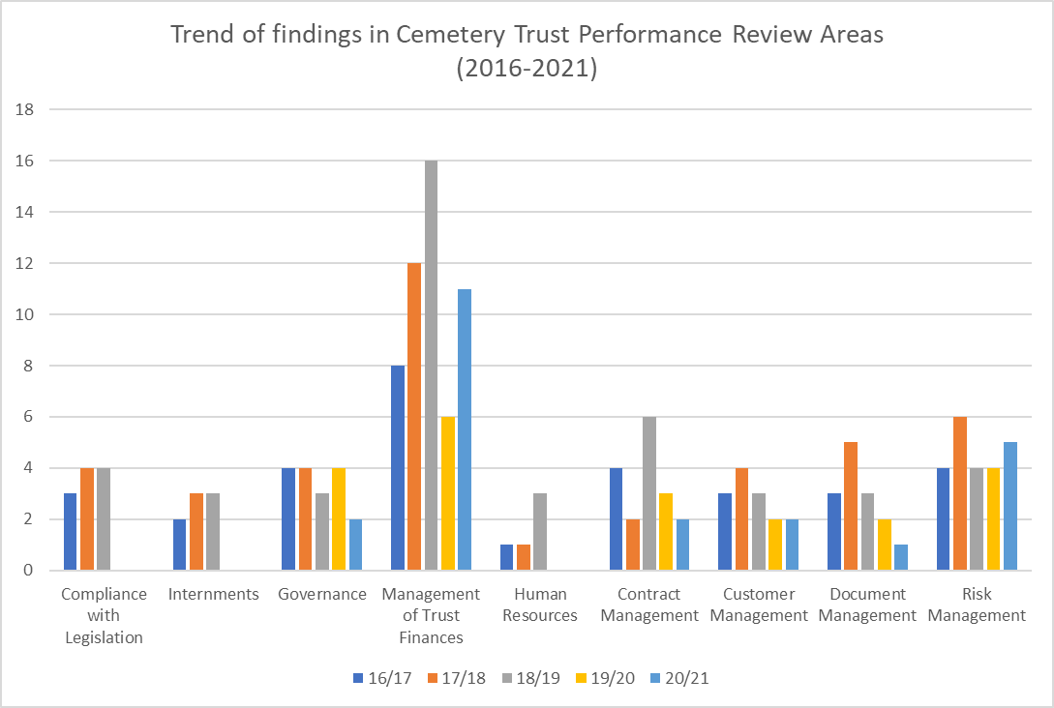
Appendix A: Summary of findings per scope area from 2016 to 2021
The table below lists the number of findings identified over the last five years in each of the major scope areas:
In general, a downward trend of findings however Trusts should focus on the following key risk areas:
Areas of weakness | Possible consequences of not taking action
Risk Management – Performing and documenting risk assessments (Financial and Non-Financial) | Trust may not know or foresee risks that could result in potential financial or reputational impact on the Trust.
Management of Trust Finances – ongoing viability of cemetery Trust | Cemetery Trust does not use its resources effectively and efficiently and lacks sufficient funds for cemetery operations and to maintain the cemetery in perpetuity.
Governance – Proper authorisation for Trust officers or members to undertake functions and exercise powers under the Act. (Instrument of Delegation) | Trust officers or members (the Secretary in particular) may undertake duties and exercise powers for which they do not have the appropriate authority.
Contract Management – Establishing formal performance processes with contractors | Risk that roles and requirements of contractors are not clearly agreed, and the Trust will not have a legal remedial arrangement in the event of a contract dispute or performance issues.

Slide 11
Appendix B. Finalising the Performance Support Program Review report
The process flow chart below describes the steps that the Trust should follow after receiving the draft report from NTT:
Trust must assign a reasonable time to complete the management action and be aware of the following:
Leaving a high or medium risk finding unresolved may lead to serious consequences if the risk eventuates
Suggested target date and action:
DH recommends that High and Medium risk actions should be completed within 8 months
Where the action involves documenting processes or creating policies, the Trust should go to the DH website to identify whether there are templates available to be used, or seek assistance from another Cemetery Trust
Fieldwork completion
Review report and amendments
Discuss Trust Action plan and completion date with NTT
Insert relevant Trust Action Plan in the recommendation section
Insert Target Completion date
Assign appropriate Trust member to Action
Finalise Report with NTT
Note: Under section 12A(1)(i) of the Cemeteries and Crematoria Act 2003 (the Act) Class A cemeteries are required to provide leadership, assistance and advice as requested to Class B cemetery trusts

Slide 12
C. Useful References and Templates available to Trusts
DH has developed and published guidelines, templates and reference guides for Trusts to review, adapt and implement.according to their needs. These are available on the Cemetery Trust Governance Page on the DH website (https://www2.health.vic.gov.au/public-health/cemeteries-and-crematoria/governance-and-finance/governance/class-b-governance) and the Policy Template Page (https://www2.health.vic.gov.au/public-health/cemeteries-and-crematoria/governance-and-finance/policy-templates)
Guidelines and Manuals
Financial Guidelines Class B Cemetery Trusts
Manual for Victorian Class B Cemetery Trusts
Secretary’s Directions to Cemetery Trusts
Templates
Cash management, gifts benefits and hospitality, memorialisation, monumental mason
Fraud, Corruption Control and Protected Disclosure Framework
Instrument of Delegation
Protective Data Security Plan
Procurement
  Guidelines for public construction procurement in Victoria
  Purchasing and Tendering Policy
  Contractor Policy
Complaints
  Complaints Policy
  Guide for managing complaints
  (Information on complaints is available at https://www2.health.vic.gov.au/public-health/cemeteries-and-crematoria/complaints)
Right of Interment
  Permit
  Fact Sheet
    The Right of Interment Permit and Fact Sheet is available at
    https://www2.health.vic.gov.au/public-health/cemeteries-and-crematoria/rights-of-interment/right-of-interment-permit

Slide 13

September 2021
Together we do great things

